Slide 1
Operating System and Unix Programming Sessional
Topic: Linux/Unix Commands for Beginners
Sessional - 01
Md Rafiqul Islam
Lecturer, Dept of IoT and Robotics, BDU

Slide 2
Introduction To Linux
Linux has a graphical user interface and it works pretty much like the GUI’s on other systems that you are familiar with such as Windows and OSX.
This tutorial won’t focus on these as I reckon you can probably figure that part out by yourself.
This tutorial will focus instead on the command line (also known as a terminal) running Bash.
Some basic Linux tutorial for beginners:
The Command Line- What is it, how does it work and how do I get to one.
File Manipulation- How to make, remove, rename, copy and move files and directories.
Vi Text Editor- Discover a powerful Linux based text editor.
Wildcards- Also referred to as globbing, this is a means to refer to several files in one go.
Permissions- Learn to identify and change the permissions of files and directories and what the conse quences of these are.

Slide 3
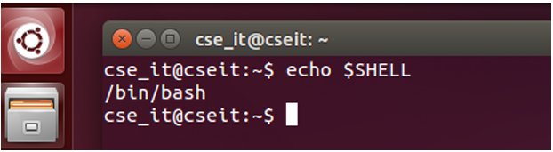
Cont…
The Command Line
A command line, or terminal, is a text based interface to the system. You are able to enter commands by typing them on the keyboard and feedback will be given to you similarly as text.
Opening a Terminal
If on Linux then you will probably find it in Applications-> System or Applications-> Utilities. Alternatively, you may be able to ’right-click’ on the desktop and there may be an option ’Open in terminal’.
The Shell, Bash
Within a terminal you have what is known as a shell. This is a part of the operating system that defines how the terminal will behave and looks after running (or executing) commands for you. There are various shells available but the most common one is called bash which stands for Bourne again shell.
If you would like to know which shell you are using you may use a command called echo to display a system variable stating your current shell. echo is a command which is used to display messages.

Slide 4
Cont..
Command | Description | Command | Description
pwd | Print working directory, e.g., /home/<username> if at your home directory. | rm | Remove file or directory.
ls | List directory contents; if no directory specified, lists current directory contents. | touch | Create a single empty file.
cd | Change directory to specified directory. | mkdir | Create new directory, specify a name.
cd .. | Change directory one level up. | rmdir | Remove empty directory, only if it's empty.
cd ∼ | Change to home directory. | chmod | Change file permission, stands for change mode in Linux.
cp | Copy a file or directory, similar to Copy-Paste in GUI. | clear | Clear terminal screen.
mv | Move or rename files, similar to Cut-Paste in GUI. | exit | Exit from terminal.

Slide 5
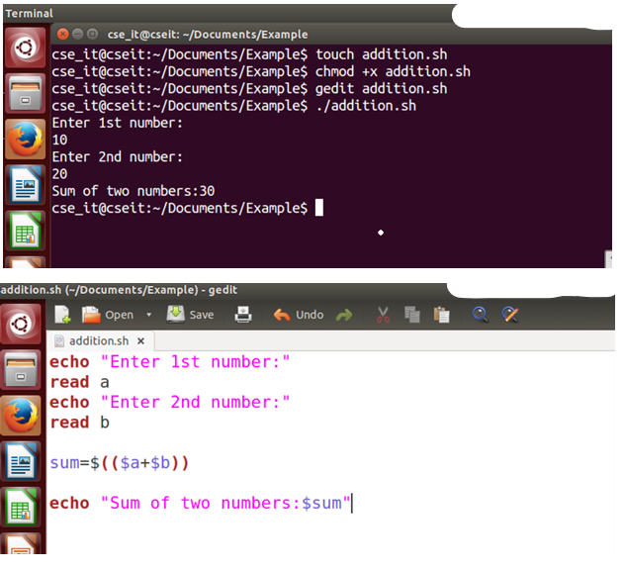
Run bash program in Linux
Making a bash script is a lot simpler than you might think.
Create a file called addition.sh, using the touch command.
Open the file using gedit command and edit the file with the program of your choice.
In order to run a file directly, we’ll need to change the permissions to allow the script to be executable for the user. chmod is a command that changes permissions on a file, and +x will add execute rights to the script.
you can execute program simply using ./addition.sh [Note that: ./, which means a file in the current directory.]

Slide 6
Vi Text Editor
Vi is a command line text editor, more powerful than Notepad on Windows or Textedit on Mac.
Operates within a single window environment with text input and output only, no mouse support.
Designed for two modes: Insert (or Input) mode and Edit mode.
Insert Mode: Allows you to enter text into the file.
Edit Mode: Enables navigation, deleting, copying, searching, replacing, saving, etc.
Users often mistakenly enter commands without switching modes, but errors are generally easy to recover from.
You start in Edit mode, switch to Insert mode by pressing i.
To return to Edit mode, press Esc.

Slide 7
Saving and Exiting in Vi
If you are unsure if you are in edit mode or not you can look at the bottom left corner. As long as it doesn’t say INSERT you are fine. Alternatively you can just press Esc to be sure. If you are already in edit mode, pressing Esc does nothing so you won’t do any harm.
ZZ (Note: capitals)- Save and exit
:q! - discard all changes, since the last save, and exit
:w - save file but don’t exit
:wq - again, save and exit

Slide 8
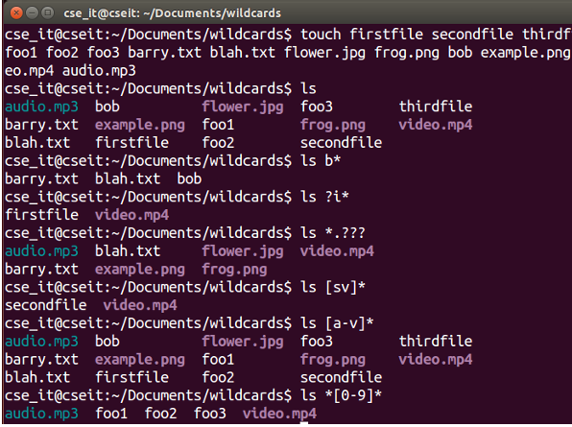
Wildcards
Wildcards are a set of building blocks that allow you to create a pattern defining a set of files or directories.
As you would remember, whenever we refer to a file or directory on the command line we are actually referring to a path.
Whenever we refer to a path we may also use wildcards in that path to turn it into a set of files or directories.
Here is the basic set of wildcards:
* - represents zero or more characters
? - represents a single character
[] - represents a range of characters

Slide 9
Permissions
Linux permissions dictate 3 things you may do with a file, read, write and execute. They are referred to in
Linux by a single letter each.
r read - you may view the contents of the file.
w write - you may change the contents of the file.
x execute - you may execute or run the file if it is a program or script.
For every file we define 3 sets of people for whom we may specify permissions.
Owner - a single person who owns the file. (typically the person who created the file but ownership may be granted to someone else by certain users)
Group - every file belongs to a single group.
Others - everyone else who is not in the group or the owner.
Three permissions and three groups of people. That’s about all there is to permissions really. Now let’s see how we can view and change them.

Slide 10
View Permissions
To view permissions for a file we use the long listing option for the command ls.
ls −l [path]
ls−l/home/ryan/linuxtutorialwork/frog.png
−rwxr−−−−x1harryusers2.7KJan407:32/home/ryan/linuxtutorialwork/frog.png

Slide 11
Change Permissions
To change permissions on a file or directory we use a command called chmod.
It stands for change file mode bits which is a bit of a mouthful but think of the mode bits as the permission indicators.
Chmod [permissions] [path]
Chmod has permission arguments that are made up of 3 components
Who are we changing the permission for?
[ugoa] - user (or owner), group, others, all
Are we granting or revoking the permission - indicated with either a plus(+) or minus(-)
Which permission are we setting ?
- read (r) , write (w) or execute (x)

Slide 12
Example
Grant the execute permission to the group. Then remove the write permission for the owner
Ls −l frog.png
−rwxr−−−−x l harry users 2.7K Jan 4 07:32 frog.png
chmod g+x frog.png
ls − l frog.png
−rwxr−x−−x l harry users 2.7 K Jan 4 07:32 frog.png
chmod u−w frog.png
ls −l frog.png
−r−xr−x−−x l harry users 2.7 K Jan 4 07:32 frog.png

Slide 13
Cont…
Don't want to assign permissions individually? We can assign multiple permissions at once.
ls -1 frog.png
-rwxr ---- x l harry users 2.7K Jan 4 07:32 frog.png
chmod g+wx frog.png
ls -1 frog.png
-rwxrwx -- x l harry users 2.7K Jan 4 07:32 frog.png
chmod go-x frog.png
ls -1 frog.png
-rwxrw ---- l harry users 2.7K Jan 4 07:32 frog.png

